Slide 1
Selenium Training
Version 3.1
November 2013

Slide 2
Agenda
Course Objectives
Automation Overview
Basics Of Java
Selenium Overview
Sauce Labs Overview
Appendix

Slide 3
Course Objectives
The objective of this course is to provide an introduction to test automation concepts, Selenium, and Sauce Labs. Depending on your current automation background, you can start one of the sections:
Course Progression Options
Start With… | If Your Background Is…
Section 1: Automation Overview | Brand new to automation and/or need a refresher on core automation concepts
Section 2: Selenium Overview | Automation experience with other tools but have not used Selenium
Section 3: Sauce Labs Overview | Automation experience with Selenium, but are new to Sauce Labs
Additional Reference Materials
Area | Description
Accenture Java Training | Recommended as a pre-requisite for those without a background in Java
Accenture Java Coding Standards | A helpful reference for consistent coding standards that can be followed
Accenture Portal for Java | Overall portal with a number of helpful materials and assets available on Java
Note: Selenium has a number of programming languages supported, but this course will focus on the Java bindings

Slide 4
Agenda
Course Objectives
Automation Overview
- | Definition, Objectives, Critical Success Factors
- | Automation Lifecycle
- | Identifying Automation Opportunities
- | Automation Framework Principles
Basics Of Java
Selenium Overview
Sauce Labs Overview

Slide 5
Test Automation Overview
Test Automation is often defined is different ways – broadly speaking, it includes automation throughout the full testing lifecycle, not just automation of test execution.
Incomplete Definitions (The Bad)
Common Misperceptions (The Ugly)
Definition 1: The use of a testing tool to record scripts for automated playback
Definition 2: The set of tools and procedures that support test execution from script automation to defect tracking and resolution
Misperception 1: “If I buy some test automation tools, it will guarantee I will save money.”
Misperception 2: “Once I automate testing, I can eliminate all testers.”
Misperception 3: “An automated testing tool will help me find 30% more bugs than manual testing.”
Misperception 4: “An automation tool will generate my test plans for me.”
Misperception 5: “Test automation only involves script recording & playback.”
Misperception 6: “We should automate 100% of our test execution.”
More Complete Definitions (The Good)
Definition 3: The suite of tools and procedures that support automation of the full testing lifecycle from test planning to test prep, execution, management, and reporting
Definition 4: Automation is a by-product of proper application and test design

Slide 6
Test Automation: Common Objectives and Opportunity Areas
Automation can help meet a number of objectives, and it makes the most sense to focus first on areas with high repeatability and stability:
Common Automation Objectives:
Cost Savings (and Cost Avoidance) Re-prioritize manual execution labor
Speed to Market Reduce test cycle execution time
Quality Increase functional test coverage
Primary Areas of Opportunity for Automation of Test Execution | Potential Coverage
Regression Testing | High
Smoke Testing / Environment Shakedown | Moderate to High
Non-GUI (e.g. backend, IVR, database, Web Services, etc) | Moderate to High
Data Creation | Low to Moderate
New Functionality Testing | Low to Moderate

Slide 7
Automation Critical Success Factors
Regardless of which process is being implemented, automation has more involved than just buying a tool and installing it:
Automation Critical Success Factors
What should be automated?
How is test automation integrated into the bigger testing picture?
What are the typical pitfalls of automating testing?
How do I measure the actual benefit from test automation?
We’ve tried automation, and it was a failure… why?
What kind of test / QA organization will support test automation?
What skills matrix will make test automation successful?
What ROI can I expect from a successful test automation capability?
What impact does an automation tool have on all of the above?
Important: Automation is a software development effort, therefore it’s important to define: Methods, Version Control, Unit Testing, Script Storage, Naming Conventions, Coding Standards, Maintenance, and Release Management.

Slide 8
Test Automation Lifecycle
Development of automation follows a defined lifecycle, with core development phases and supporting areas – more detail on each of these is available in the Test Automation Handbook:
Core Activities
Regression Suite Maintenance
Analysis
Automation Development
(UI and Non-UI)
Test Execution
Automation Framework Definition
Reporting & Project Management
Test Data Management
Supporting Areas
ROI and Benefit Measurement
Team Structure, Progression, Proficiency
Tool Options
Services Testing and Virtualization

Slide 9
Identifying Automation Opportunities
A key success factor with test automation is ensuring automation is focused in the right areas – Accenture has checklists to assist with this step, and high-level criteria is shown below:
Criteria | Guiding Principles
The tests to be automated contain a defined number of repeatable steps | If it is possible to write scripts and wrappers that will automate testing then this should be done especially if they are run multiple times.
Test cases are stable and will be executed at least 4 times a year | It has been shown that test cases should be automated if they are executed more than 4 times a year as the cost of creating the automated scripts will be more than offset by the savings in execution.
The testing is part of a multiple phase program | The more times the automated test scripts are executed the greater the benefit of using automation.
The requirements and designs are stable | This reduces the amount of maintenance required for the automated test scripts. An unstable design will require a large number of ongoing changes to the automated test scripts, which reduces the benefits of test automation.
The tests have predictable results | Automated tests must have a clear and binary result i.e. it can be clearly established if the test passed or failed.
Well-structured test scripts have previously been executed manually | Tests can be a good fit for automation if they have previously been successfully executed manually. Note: consideration does not apply for in-cycle automation.

Slide 10
Automation Framework: Guiding Principles
It is important to establish an automation framework, regardless of the tool being used – the following principles should be present in the framework that is implemented:
Area | Guideline
Modularity | Modularize automated test scripts for multiple execution combinations, improved reuse, and reduced maintenance.
Common Functions | Identify and abstract common functions used across multiple test scripts. Reduce duplication of code.
Decouple Business Logic | Decouple complex business function testing from navigation and other simple verification and validation.
Decouple Test Data | Abstract and decouple test data from the test scripts.
Error Recovery | Structure scripts with minimal inter-dependencies, and implement error recovery. Ensure scripts can run unattended even when failures occur
Repeatable, Unattended Execution | Aim to enable required blocks of scripts to be executed in a repeatable fashion, with minimal manual intervention.
Note: For more details on automation frameworks, please see the Test Automation Handbook.

Slide 11
Agenda
Course Objectives
Automation Overview
Basics Of Java
- | Introduction
- | Concepts In Java
- | Basic Syntax
- | Classes
- | Loops & Decision Making Statement
- | Array
Selenium Overview
Sauce Labs Overview
Appendix

Slide 12
Java - Introduction
Java is a high-level programming language originally developed by Sun Microsystems, is an object-oriented language, similar to C++. Java runs on a variety of platforms, such as Windows, Mac OS, and the various versions of UNIX.
Features of Java :
Write Once, Run Anywhere.
Object Oriented
Platform Independent
Simple
Secure
Portable

Slide 13
Concepts In Java
Java is an Object Oriented Language. As a language that has the Object Oriented feature, Java supports the following fundamental concepts:
Polymorphism
Inheritance
Encapsulation
Abstraction
Classes
Objects
Instance
Method
Message Parsing

Slide 14
Basic Syntax
Case Sensitivity - Java is case sensitive which means identifier Hello and hello would have different meaning in Java.
Class Names - For all class names the first letter should be in Upper Case.
Method Names - All method names should start with a Lower Case letter. If several words are used to form the name of the method, then each inner word's first letter should be in Upper Case. Example public void myMethodName()
Program File Name - Name of the program file should exactly match the class name. When saving the file we should save it using the class name and append '.java' to the end of the name. (if the file name and the class name do not match our program will not compile).
Public static void main(String args[]) - java program processing starts from the main() method which is a mandatory part of every java program.

Slide 15
Basic Syntax contd..
When we consider a Java program, it can be defined as a collection of objects that communicate via invoking each others methods. Let us now briefly look into what do class, object, methods and variables mean:
Object - Objects have states and behaviors. Example: A dog has states-color, name, breed as well as behaviors -wagging, barking, eating. An object is an instance of a class.
Class - A class can be defined as a template/ blue print that describe the behaviors/states that object of its type support.
Methods - A method is basically a behavior. A class can contain many methods. It is in methods where the logics are written, data is manipulated and all the actions are executed.
Variables - A variable refers to the memory location that holds values like: numbers, texts etc. in the computer memory. A variable is a name of location where the data is stored when a program executes.

Slide 16
Classes In Java
A class defines the properties of objects and methods used to control an object's behavior. In terms of object-oriented programming, the class is like a template from which an instance (object) of a class is created at run time.
Classtest.java import java.lang.*; public class Classtest{ public static void main( String args[] ) { Example myExample = new Example(); myExample.display(); } } class Example { public void display(){ System.out.println( "It's an example of class" ); } }

Slide 17
Loops in Java
Java has very flexible three looping mechanisms. You can use one of the following three loops:
while Loop
do...while Loop
for Loop
The for Loop:
A for loop is a repetition control structure that allows you to efficiently write a loop that needs to execute a specific number of times.
Syntax:
for(initialization; Boolean_expression; update)
{ //Statements}

Slide 18
Decision Making Statements
There are two types of decision making statements in Java. They are:
if statements
switch statements
The if...else Statement:
An if statement can be followed by an optional else statement, which executes when the Boolean expression is false.
Syntax:
if(Boolean_expression)
{ //Executes when the Boolean expression is true}
else{ //Executes when the Boolean expression is false}

Slide 19
Array
Array stores a fixed-size sequential collection of elements of the same type. An array is used to store a collection of data, but it is often more useful to think of an array as a collection of variables of the same type.
Declaring Array Variables:
dataType[] arrayRefVar;
or
dataType arrayRefVar[];
Creating Arrays:
arrayRefVar = new dataType[arraySize];
dataType[] arrayRefVar = new dataType[arraySize];
dataType[] arrayRefVar = {value0, value1, ..., valuek};

Slide 20
Agenda
Course Objectives
Automation Overview
Basics Of Java
Selenium Overview
- | Introduction
- | Selenium IDE
- | Creating and Executing Your First Test
- | Design Patterns
- | Selenium Grid
- | TestNG Framework
Sauce Labs Overview
Appendix

Slide 21
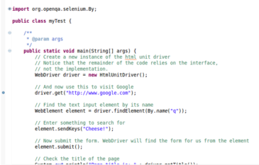
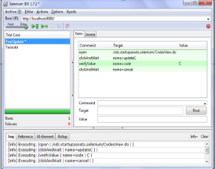
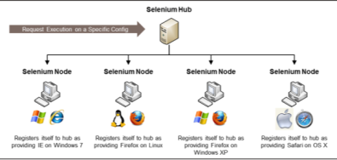
Selenium Introduction
Selenium is a suite of tools that helps automate web-based applications - the Selenium toolset includes the following:
Selenium 2.0 (Selenium WebDriver)
A collection of language-specific bindings that helps drive a browser – provides an API for automation of web applications.
Selenium Grid
Allows Selenium test suites to be run in parallel on different remote machines whit different environments (OS, browser).
Selenium IDE
Firefox plugin for building test scripts with a recording feature, which can then be exported as a reusable script.
This training will focus mostly on Selenium WebDriver and some parts of Selenium-Grid, as these two are most commonly used to establish robust automation in Selenium. But before that, it helps to understand the Selenium IDE at a high-level, as it gives a good starting point on understanding Selenium.
Note: At the time these materials were created, Selenium 3.0 had recently been announced and targeted for release at the year-end of 2013. See this blog post for more details.

Slide 22
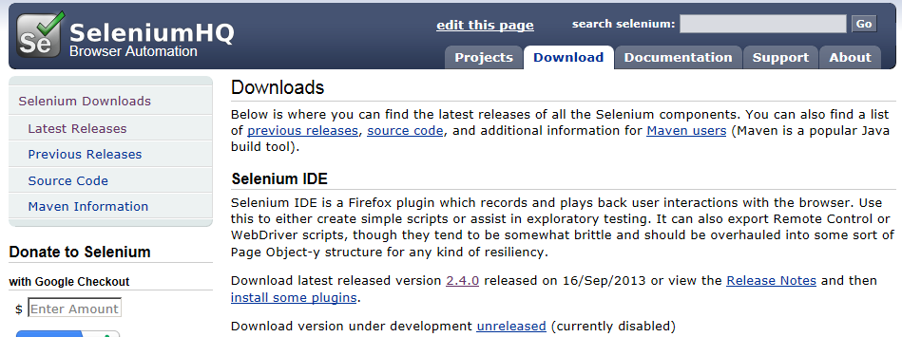
Selenium IDE
Selenium-IDE is the Integrated Development Environment for building Selenium test cases. Mainly, it is a user interface that allows the user to:
a. Create/Record the Automation scripts.
b. Modify the Automation scripts.
c. Running the Automation scripts.
Installation
Download Selenium IDE from SeleniumHQ
To Install Selenium IDE, just drag-and-drop Selenium IDE XPI file into Firefox Taskbar
Open Mozilla Firefox
Click on “Tools” option
Select “Selenium IDE”
NOTE: By default, selenium IDE starts in recording mode

Slide 23
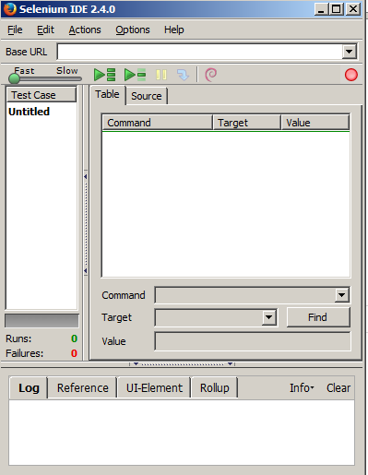
IDE UI
Base URL of application under test
Record test
Run, stop, pause
Adjust execution speed
Commands for the actual test
Log of commands executed and any errors

Slide 24

IDE Workflow
When you look at the IDE table , there are 3 columns:
1. Command
2. Target
Command tells Selenium what to do
Ex: They do things like "click this link" and "select that option". If an Action fails, or has an error, the execution of the current test is stopped.
We can check the state of the application and store the results in variables, e.g."storeTitle".
The default commands generated by selenium when you are browsing the page as a normal user should be modified to make the test more robust and to add test cases to it.
For ex: Replace all click commands by clickAndWait. click simply clicks the specified link and goes on to execute the next command without waiting.
On the other hand clickAndWait waits for the new page to loaded before executing the next command. clickAndWait should be used to make more robust test cases.
Element Locators tell Selenium which HTML element a command refers to.
Selenium supports the following strategies for locating element: id, name, xpath, dom, identifier, link and css
Id and name: Whenever you open any web page, right click and try to view the source code. You will come across id or name for the web object. Based on this , user can uniquely identify the webobjects such as textbox, listbox, radio button etc.., Each will be having it's own id , name.
xpath: To put it in a simple way, xpath is like hierarchy or the order used to identify any object.
Link: Select the link element which contains text matching the specified pattern. Ex: link=The link text
Ex: Select the element using css selectors. Ex: css=a[href="#id3"]
3. Value
Gives the value for the given command to enter in the target (i.e. enter ‘Test123’ in First Name box)

Slide 25
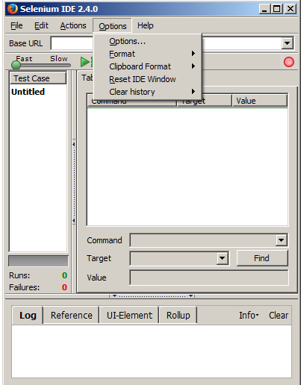
IDE Customization (1 Of 2)
Click Here

Slide 26
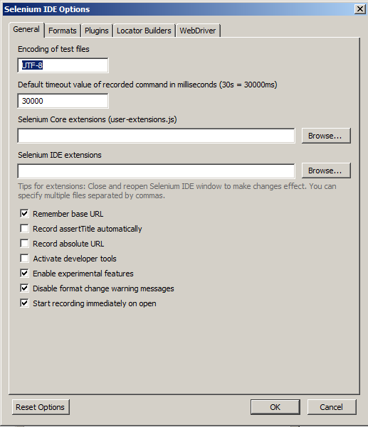
IDE Customization (2 Of 2)
User can Optimized general Selenium IDE options (ex: Changing the default timeout)

Slide 27
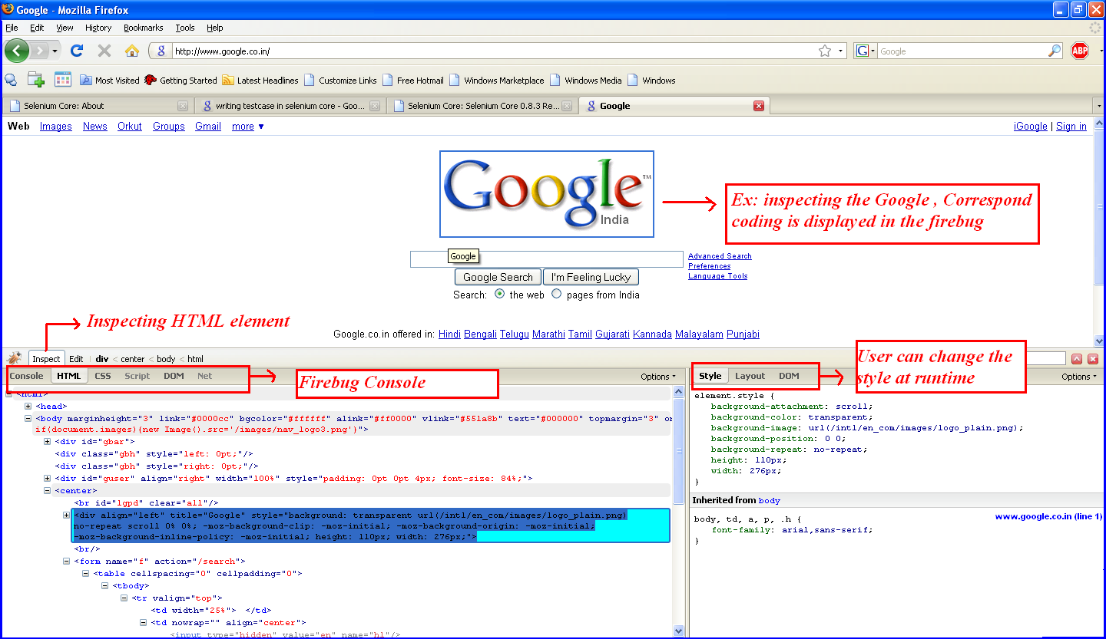
Firebug

Slide 28
Advantages and Disadvantages of Selenium IDE
Advantages
Disadvantages
It is a Freeware
Simple, Easy to install, Easy to work
Selenium IDE is the only flavor of Selenium which allows you to record user action on browser window.
Can also record user actions in most of the popular languages like Java, C#, Perl, Ruby
It will not record any operation that you do on your computer apart from the events on Firefox browser window
During recording if you right click on any element it will show all the selenium commands available.
You can also edit existing command, by selecting it and editing on the boxes available
You can also insert/delete commands by choosing appropriate option after right clicking
Choose appropriate run option - i.e walk, run or test runner and review your results
Limitation in terms of browser support (It runs only in Mozilla)
Not allowed to write manual scripts like conditions and Loops for Data Driven Testing
There is no option to verify images.

Slide 29
WebDriver Options
There are multiple implementations of WebDriver available for use that map to the different supported browsers:
Driver | Description
HtmlUnit Driver | This is the fastest and most lightweight implementation of WebDriver. This is based on HtmlUnit (a java based implementation of a web browser without a GUI).
Firefox Driver | Controls the Firefox browser using a Firefox Plugin. Is capable of being run on Windows, Mac and Linux.
Internet Explorer Driver | Controls the IE browser with through a .dll, and is thus only available on Windows OS.
Chrome Driver | Is maintained/supported by the Chromiun project. WebDriver works with Chrome through the chromedriver (Chromium project) binary. You need to have both chromedriver and a version of chrome browser installed. chromedriver needs to be placed somewhere on your system’s path in order for WebDriver to automatically discover it. The Chrome browser itself is discovered by chromedriver in the default installation path.
Opera Driver | OperaDriver is a vendor-supported WebDriver implementation developed by Opera Software and volunteers that implements WebDriver API for Opera.
ios-driver | Helps test any IOS native, hybrid, or mobile web application using the Selenium / Webdriver API. (note: recommended over iPhone Driver when using emulators only. Another alternative is appium)
Android Driver | Android WebDriver allows to run automated end-to-end tests that ensure your site works correctly when viewed from the Android browser.

Slide 30
Creating Your First Web driver object
Creating HtmlUnit driver
HtmlUnitDriver driver = new HtmlUnitDriver(true);
Creating firefox WebDriver object
WebDriver driver = new Firefox Driver();
Creating Chrome WebDriver object
WebDriver driver = new ChromeDriver();
Creating Android WebDriver object
WebDriver driver = new Android Driver();
Creating IOS WebDriver object
WebDriver driver = new IPhoneDriver();

Slide 31
WebDriver API Command & Operations: Basics
The following section shows some options within WebDriver for some commonly used commands:
Navigation Basics
Locating UI Elements
User Input: Filling Forms
Moving Between Windows and Frames
Pop-Up Dialogs

Slide 32
WebDriver API Command & Operations: Navigation
Overall Notes:
The Navigate interface allows for navigating between pages.
Navigate To a URL
Navigate Between Pages
Code:
driver.get("http://www.google.com");
Notes:
Dependent on several factors, including the OS/Browser combination, WebDriver may or may not wait for the page to load.
In some circumstances, WebDriver may return control before the page has finished, or even started, loading.
To ensure robustness, you need to wait for the element(s) to exist in the page using Explicit and Implicit Waits.
Code
driver.navigate().forward();
driver.navigate().back();
Notes:
navigate().to() and get() do exactly the same thing. One’s just a lot easier to type than the other: driver.navigate().to("http://www.example.com");

Slide 33
WebDriver API Command & Operations: Locating UI Elements (1 of 2)
Overall Notes:
Locating elements in WebDriver can be done on the WebDriver instance itself or on a WebElement.
Each of the language bindings expose a “Find Element” and “Find Elements” method.
The first returns a WebElement object otherwise it throws an exception.
The latter returns a list of WebElements, it can return an empty list if no DOM elements match the query.
The “Find” methods take a locator or query object called “By”
By ID
By Tag Name
Code
WebElement element = driver.findElement(By.id(" id1 "));
Notes:
This is the most efficient and preferred way to locate an element.
<div id=“id1">...</div>
Code
WebElement frame = driver.findElement(By.tagName("iframe"));
Notes:
The DOM Tag Name of the element.
<iframe src="..."></iframe>
By Name
By XPath
Code
WebElement cheese = driver.findElement(By.name("cheese"));
Notes:
Find the input element with matching name attribute.
<input name="cheese" type="text"/>
Code
List<WebElement> inputs = driver.findElements(By.xpath("//input"));
Notes:
WebDriver uses a browser’s native XPath capabilities wherever possible. On those browsers that don’t have native XPath support, it provides its own implementation.
This can lead to some unexpected behavior unless you are aware of the differences in the various XPath engines.

Slide 34
WebDriver API Command & Operations: Locating UI Elements (2 of 2)
By CSS
By Class
Code
WebElement css = driver.findElement(By.cssSelector("#food span.dairy.aged ")); Notes:
Like the name implies it is a locator strategy by css. Native browser support is used by default.
<div id="food">
<span class="dairy">milk</span>
<span class="dairy aged">cheese </span>
</div>
Code
List<WebElement> cheeses = driver.findElements(By.className(“classname"));
Notes:
Class in this case refers to the attribute on the DOM element.
There might be many DOM elements with the same class name, thus finding multiple elements becomes the more practical option over finding the first element.
<div class=" classname "><span>Cheddar</span></div>
<div class=" classname "><span>Gouda </span></div>
By Partial Link Text
By Using JavaScript
Code
WebElement cheese = driver.findElement(By.partialLinkText("cheese")); Notes:
Find the link element with partial matching visible text.
<a href="http://www.google.com/search?q=cheese">search for cheese</a>>
Code
WebElement element = (WebElement) ((JavascriptExecutor)driver).executeScript("return $('.cheese')[0]");
Notes:
You can execute arbitrary javascript to find an element and as long as you return a DOM Element, it will be automatically converted to a WebElement object.

Slide 35
WebDriver API Command & Operations: User Input
Overall Notes:
…
Interacting with Text Elements
Interacting with Select Elements
Code
driver.findElement(By.name("value")).sendKeys(“XXXXX");
Notes:
..
Code
Select select = new Select(driver.findElement(By.tagName("select")));
select.deselectAll();
select.selectByVisibleText("Edam");
Notes:
This will deselect all OPTIONs from the first SELECT on the page, and then select the OPTION with the displayed text of “Edam”
Clicking a Submit Button
Code
driver.findElement(By.id("submit")).click();
Notes:
Alternatively, WebDriver has the convenience method “submit” on every element. If you call this on an element within a form, WebDriver will walk up the DOM until it finds the enclosing form and then calls submit on that.
If the element isn’t in a form, then the NoSuchElementException will be thrown:
element.submit();

Slide 36
WebDriver API Command & Operations: Windows, Frames, and Popups
Overall Notes:
Some web applications have many frames or multiple windows. WebDriver supports moving between named windows using the “switchTo” method.
Switch Between Windows
Switch Between Frames
Code
driver.switchTo().window("windowName");
Notes:
Alternatively, you can pass a “window handle” to the “switchTo().window()” method. Knowing this, it’s possible to iterate over every open window: for (String handle : driver.getWindowHandles()) {
driver.switchTo().window(handle);
}
Code
driver.switchTo().frame("frameName");
Notes:
It’s possible to access subframes by separating the path with a dot, and you can specify the frame by its index too. That is: driver.switchTo().frame("frameName.0.child");
Handling Pop-Ups
Code
Alert alert = driver.switchTo().alert();
Notes:
This will return the currently open alert object. With this object you can now accept, dismiss, read its contents or even type into a prompt. This interface works equally well on alerts, confirms, and prompts.

Slide 37
Sample Test
public class SampleTest1 {
private WebDriver driver;
private String baseUrl;
@Before
public void setUp() throws Exception {
System.setProperty("webdriver.chrome.driver", "C:\\Users\\jiten.adhikari\\Desktop\\Selenium\\Drivers and Plugin\\chromedriver.exe");
driver = new ChromeDriver();
baseUrl = “/";
driver.manage().timeouts().implicitlyWait(30, TimeUnit.SECONDS);
}
@Test
public void testUntitled() throws Exception {
driver.get(baseUrl + “/”)
driver.findElement(By.id("enterID-input")).sendKeys("FTIVT.BZCM");
driver.findElement(By.cssSelector("a[name=\"enter-online-id-submit\"] > span")).click();
}
@After
public void tearDown() throws Exception {
driver.quit();
}

Slide 38
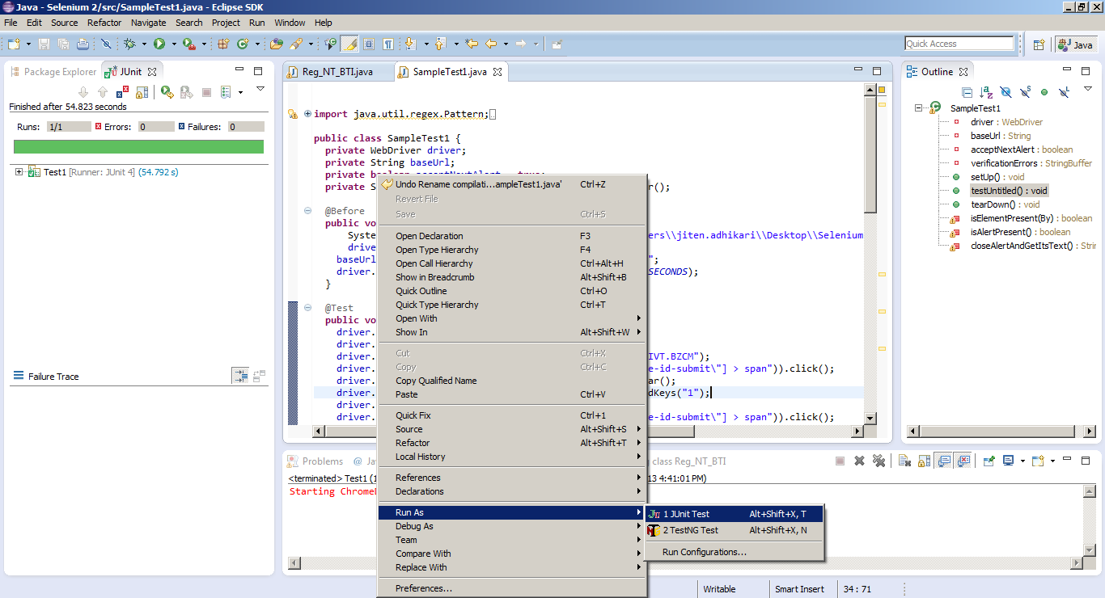
Executing the Test

Slide 39
Design Structure of a Selenium Test
Code structure is as show below
1. Import all the jar files
import java.util.regex.Pattern; // all the jar files needed for selenium code should be imported
2.@ Before
@Before // Before signifies the code that will be executed before the test code is run , it invokes the browser driver .
public void setUp() throws Exception {
driver = new ChromeDriver();}
3.@ Test
@Test // Test signifies the actual test code that will be executed .
public void testUntitled() throws Exception {
…………..
…………}
4.@ After
@After // After signifies the code that will run after the test code run is completed
public void tearDown() throws Exception {
driver.quit();
}
Sample code is attached

Slide 40








Selenium Grid
Selenium Grid allows tests to scale by distributing tests on several machines, so they can be run in parallel, against different remote machines with different environments:
Definitions
Setup Notes
Selenium Hub
The hub is the central point that will receive all the test request and distribute them the right nodes
Selenium Nodes:
The nodes are the points where test cases will be executed. The nodes will be different machines with different browsers and OSs.
See this three part series on a blog of an example of how to setup and configure the Grid: Part 1, Part 2, Part 3
See this blog post for an example of how to design tests for optimal cross-browser usage.
Selenium Test 1
Selenium Hub
Selenium Test 2
Request Execution on a Specific Config
Selenium Test 3
Selenium Test 4
Selenium Node
Selenium Node
Selenium Node
Selenium Node
Registers itself to hub as providing IE on Windows 7
Registers itself to hub as providing Firefox on Linux
Registers itself to hub as providing Firefox on Windows XP
Registers itself to hub as providing Safari on OS X

Slide 41
TestNG Framework
TestNG is a testing framework inspired from JUnit and NUnit but introducing some new functionalities that make it more powerful and easier to use.
What is TestNG?
Definitions
TestNG is an open source automated testing framework; where NG of TestNG means Next Generation. TestNG is similar to JUnit (especially JUnit 4), but its not a JUnit extension. Its inspired by JUnit. It is designed to be better than JUnit, especially when testing integrated classes.
TestNG eliminates most of the limitations of the older framework and gives the developer the ability to write more flexible and powerful tests
TestNG Features
Annotations.
TestNG uses more Java features.
Support for multi threaded testing
Supports Dependent test methods, parallel testing, load testing, partial failure.
Separate compile-time test code from run-time configuration/data info
Benefits of using annotations
TestNG identifies the methods it is interested in by looking up annotations. Method names are not restricted to any pattern.
We can pass additional parameters to annotations.
Annotations are strongly typed, so the compiler will flag any mistakes right away.
Test classes no longer need to extend anything (such as TestCase, for JUnit 3).

Slide 42
Data-Driven Testing using TestNG
Unlike QTP Data Driven Testing is not inbuilt in Selenium. Data Driven testing can be perform in Selenium by making use of TestNG Framework.
Following Attached Code and Data Sheet explains how TestNG Can be use to perform Data Driven Testing.

Slide 43
Selenium Resources
For more details on Selenium, see the following resources:
Link | Description
http://seleniumhq.org/ | Official website for Selenium, with documentation available.
http://code.google.com/p/selenium/ | Official Google wiki reference for Selenium
http://seleniumhq.wordpress.com/ | Official Selenium blog – latest news and updates here.
http://deors.wordpress.com/tag/selenium/ | Blog of the Accenture Java Capability Lead at the Accenture Delivery Center in Spain (Jorge Hidalgo). Contains a number of posts on Selenium.
http://www.tutorialspoint.com/testng/testng_environment.htm | Official Tutorial Website for TestNG
http://saucelabs.com/java | Official website for Sauce Lab connection with Selenium
Attribution: currently, some of the content in the WebDriver API Command & Operations section comes directly from SeleniumHQ. Intent is to revise this over time.

Slide 44
Agenda
Course Objectives
Automation Overview
Basics Of Java
Selenium Overview
Sauce Labs Overview
- | Introduction
- | Interacting with Selenium
- | Sample Tests
Appendix

Slide 45
Sauce Labs Introduction
Sauce Labs provides Virtual Machines (VMs) for a variety of OS/Browser configurations in a cloud infrastructure, allowing for remote execution of tests across a number of combinations.
Local Network
Sauce Labs Cloud Network (External)
Sauce Labs Controller
Selenium Test 1
Selenium Test 2
Selenium Test 3
Selenium Test 4
Request Execution on a Specific Config (through Sauce Labs API)
VM 1
VM 2
VM 3
VM 4
VM …
Many configs available
IE on Windows 7
Firefox on Linux
Firefox on Windows XP
Safari on OS X
Company Website: https://saucelabs.com/
Note: Sauce Connect can be used to enable a secure tunnel between the Sauce Labs cloud and local test environments (not publicly available)

Slide 46
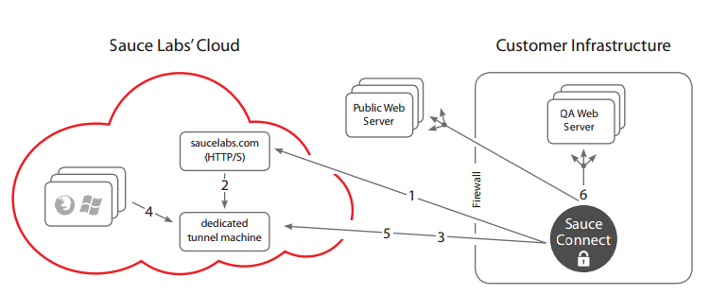
Sauce Connect Architecture Set-up Process
Attribution: https://saucelabs.com/downloads/Sauce_Connect_Architecture.pdf
1. Sauce Connect, running on a machine inside the customer infrastructure contacts REST API in saucelabs.com and requests a tunnel machine to get started.
2. Inside Sauce’s infrastructure, the request triggers a new VM to be booted and configured. Once booted and ready, the REST API will provide its domain back to Sauce Connect Support for multi threaded testing.
3. Once the machine is ready and the domain is known, Sauce Connect will connect to this machine directly over port 443 using a special encrypted and reliable protocol created by Sauce (KPG).
4. Once the tunnel is established, all test servers driving browsers under the control of this username will be configured to proxy HTTP traffic through the dedicated tunnel machine.
Any HTTP traffic received by the dedicated tunnel machine is encrypted and sent through the tunnel and to the Sauce Connect instance running internally. Stringent firewall rules prevent this machine from receiving external HTTP traffic.
6. Once traffic is received in the Sauce Connect instance, it is decrypted and re-generated, domains are resolved to reach the local (or even public) servers that this requests were meant to reach.

Slide 47
Interacting with Sauce Labs Through Selenium
Sauce Labs lets you easily run Selenium tests against a wide range of browsers on Windows, OS X, Linux, iOS and Android. Your tests are run in real browsers on a real operating system, in a dedicated, single-use VM. Once they're complete, screenshots, video, Selenium log and a log of passes and failures can be seen and shared.
Pre-requisite for interaction of sauce Lab Through Selenium:
Latest Java (>=Java 6) version is required
Eclipse or Maven being use to build and deploy Java projects using JUNIT or TestNG Framework for testing.
Sauce OnDemand is a service that allows to run Selenium tests in our testing cloud .The IT burden of maintaining all those machines for Selenium Grid goes away and we can focus on writing tests. With Sauce Lab, we can:
Run the same script against different configurations in parallel
Instantly scale your testing efforts
Watch our script run in real time
Archive the results of a test after using the record function
Share the video playback with stakeholders or customers to showcase new functionality
Update Content

Slide 48
Sample Test(JUNIT)
public class WebDriverTest {
private WebDriver driver;
@Before
public void setUp() throws Exception {
// Choose the browser, version, and platform to test
DesiredCapabilities capabilities = DesiredCapabilities.firefox();
capabilities.setCapability("version", "5");
capabilities.setCapability("platform", Platform.XP);
// Create the connection to Sauce Labs to run the tests
this.driver = new RemoteWebDriver
( new URL("http://<username>:<access_key>@ondemand.saucelabs.com:80/wd/hub"),
capabilities);
}
@Test
public void webDriver() throws Exception {
// Make the browser get the page and check its title
driver.get("http://www.amazon.com/");
assertEquals("Amazon.com: Online Shopping for Electronics, Apparel, Computers, Books, DVDs & more",driver.getTitle());
}
@After
public void tearDown() throws Exception {
driver.quit();
}
}

Slide 49
Sample Test(TestNG)
public class WebDriverTest {
private WebDriver driver;
@Parameters({"username", "key", "os", "browser", "browserVersion"})
@BeforeMethod
public void setUp( @Optional("<username>") String username,
@Optional("<access_key>") String key,
@Optional("mac") String os,
@Optional("iphone") String browser,
@Optional("5.0") String browserVersion,
Method method) throws Exception {
// Choose the browser, version, and platform to test
DesiredCapabilities capabilities = new DesiredCapabilities();
capabilities.setBrowserName(browser);
capabilities.setCapability("version", browserVersion);
capabilities.setCapability("platform", Platform.valueOf(os));
capabilities.setCapability("name", method.getName());
// Create the connection to Sauce Labs to run the tests
this.driver = new RemoteWebDriver( new URL("http://" + username + ":" + key + "@ondemand.saucelabs.com:80/wd/hub"),
capabilities);
}
@Test
public void webDriver() throws Exception {
driver.get("http://www.amazon.com/");
assertEquals("Amazon.com: Online Shopping for Electronics, Apparel, Computers, Books, DVDs & more", driver.getTitle());
}
@AfterMethod public void tearDown() throws Exception { driver.quit(); } }

Slide 50
Agenda
Course Objectives
Automation Overview
Selenium Overview
Sauce Labs Overview
Appendix
- | Selenium Installation Instructions
- | Sauce Connect Setup (?)

Slide 51
Selenium Installation Instructions
Perquisite for installing Selenium:
JRE 6 And Above
Eclipse
Selenium Java (Can be Downloaded from Selenium Site : http://www.seleniumhq.org/download/) Latest version selenium-2.37.0. It will Come in zip File.
To run TestNG test ,TestNG plugin need to be placed inside Plugin Folder.
TestNG Plugin: org.testng.eclipse_6.1.1.20110718_1435.jar
For Complete detail on Selenium Installation please refer the PPT Place in Below Discovery Link:

